Slide 1
ARL Contributions to the WMO Atmospheric Deposition Program
Richard S. Artz
NOAA Air Resources Laboratory
June 22, 2016
Notes:
NOAA provides the Permanent Representative from the US to the World Meteorological Organization.
ARL, because of its unique relationship with the WMO and major national air quality and deposition programs, was tasked with leading the Global Atmosphere Watch Precipitation Chemistry program.
The work shown in the following slides has been performed by ARL and its contractors involved with National Atmospheric Deposition Program programs in collaboration with many international scientists.
Special thanks go to the Canadians with Environment Canada and the NADP Program Office and Central Analytical Laboratory

Slide 2
Goals
Provide Support to International Atmospheric Deposition Programs
World Meteorological Organization Global Atmosphere Watch Science Advisory Group
1998 – 2015: Precipitation Chemistry
2015 – Present: Total Atmospheric Deposition

Slide 3
Performance
Chair the WMO Science Advisory Group on Precipitation Chemistry
Assemble a group of top deposition scientists from major national or regional deposition programs
US National Atmospheric Deposition Program
Canadian Air and Precipitation Monitoring Network
European Monitoring and Evaluation Program
East Asia Network
Deposition of Biogeochemically Important Trace Species, a part of the International Global Atmospheric Chemistry program
High quality unaffiliated stations in Russia, India, Oceania, and elsewhere
Develop comprehensive programs
Guidance
Quality Assurance
Assessments

Slide 4
Relevance
Atmospheric deposition estimates are used by scientists for several key purposes:
Critical Loads calculations
Air quality modeling
Marine applications
Applications to terrestrial ecosystems
Notes:
Relevance: Atmospheric Deposition estimates are used by scientists for several key purposes:
Critical Loads. Without deposition estimates from measurements, critical loads calculations suffer. Critical loads form the backbone of environmental policy in many nations. The US does not currently use critical loads to guide emissions policy, but increasingly the approach is used to estimate effects of chemical deposition to sensitive ecosystems by the US National Parks Service and other Department of the Interior agencies.
Air quality modelers. Atmospheric deposition is an important sink term. Concentrations of various atmospheric pollutants in rain and ambient air as well as wet and dry deposition calculations are used within comprehensive atmospheric models.
Increasingly, the marine community is interested in nitrogen and phosphorous estimates of deposition to assess effects on marine ecosystems.
4. Terrestrial ecologists and agricultural scientists continue to form the backbone of the user community, assessing effects on sensitive terrestrial ecosystems.

Slide 5
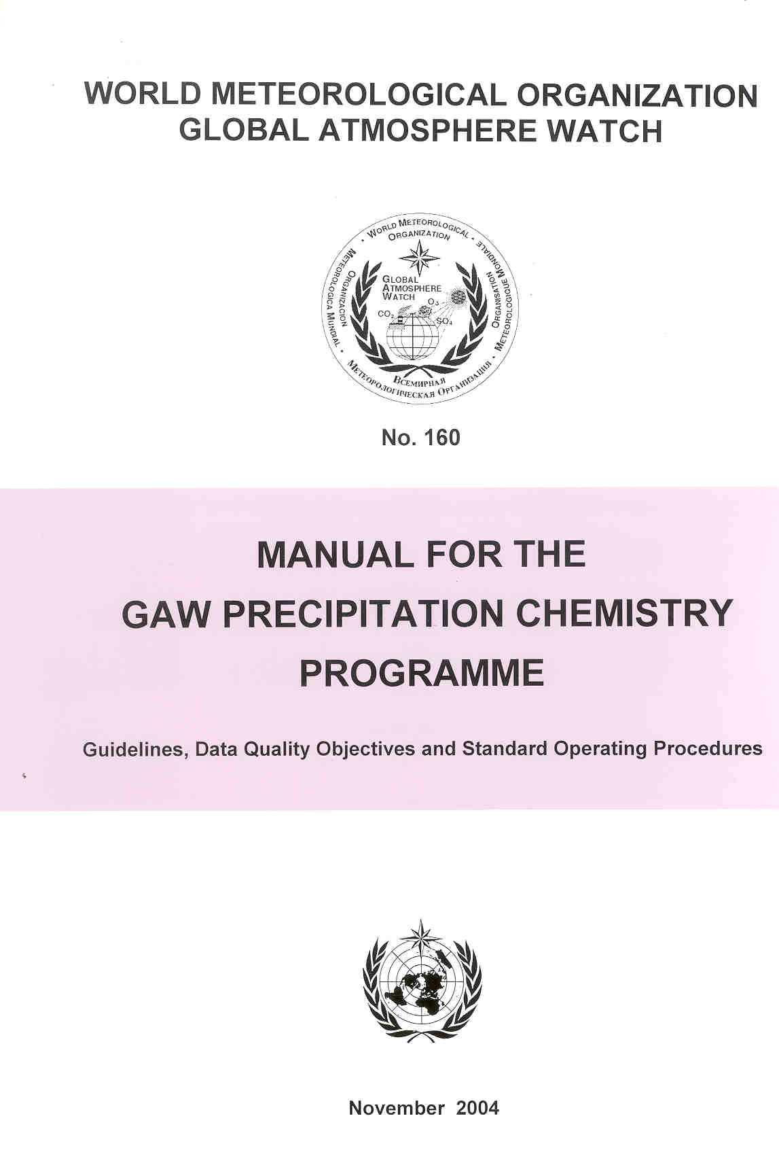
2004 Manual for the GAW Precipitation Chemistry Programme
Introduction
Siting
Field Protocols
Laboratory Operations
Data Management
Quality Control and Quality Assurance
Establishment of Data Quality Objectives
Guidelines for Data Submission
Algorithm for Sea Salt Corrections
2nd edition to be published later this year
Notes:
The Manual was produced after recognizing that many of the failing laboratories had never been instructed in the proper techniques that must be followed by a successful measurement program.
The Manual was the second major order of business handled by the Science Advisory Group after taking steps to assess quality assurance by the participating laboratories.
QA assessment approaches resulted in products for the data user to quickly determine whether data from a particular laboratory were acceptable for use in scientific studies.
Laboratories that follow the instructions in the Manual typically produce data that are useful to the scientific community.
It is readily acknowledged that participating WMO laboratories still exhibit a wide range of quality.

Slide 6
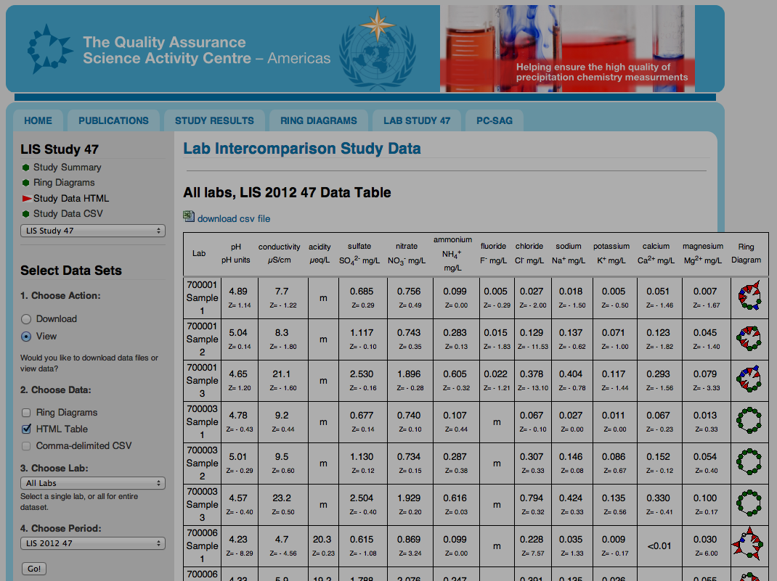
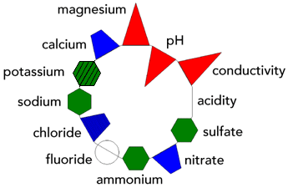
Notes:
Note: A full explanation of this process is found at QASAC-Americas.org
RELEVANCE:
Quality Assurance - Science Activity Centre (Americas)
(April 2015 – March 2016)
Website: www.qasac-americas.org
Usage statistics:
1,578 users (58% new and 42% returning)
20,036 views
Users come from 90 different countries
64% of users top 10 countries: USA (24.3%), Belarus (7.0%), Brazil (6.8%), Hong Kong (5.4%), Japan (4.4%), Poland (4.1%), Germany (4.0%), Italy (3.8%), Latvia (2.4%), S. Korea (2.4%)

Slide 7
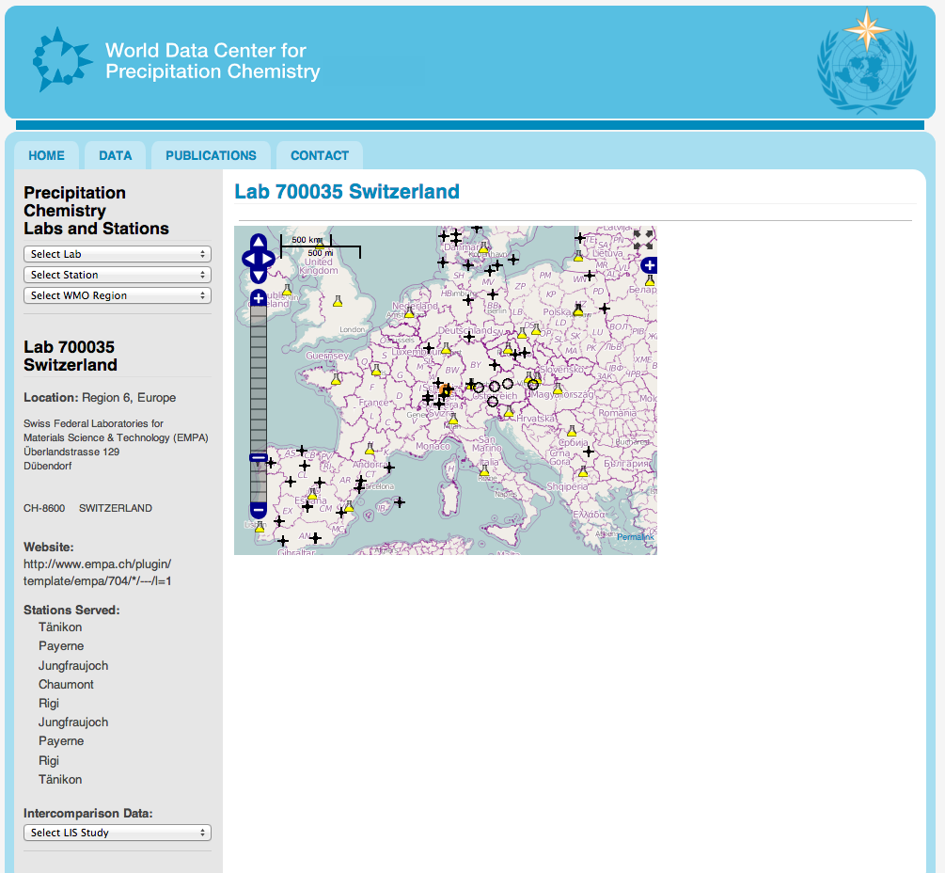
Measurement Station
Analytical Laboratory
Laboratory Information
Lab Website link
List of stations served by the lab
Link to Ring Diagrams for lab
Notes:
Quality: This was the first time in the 40 year history of the WMO precipitation chemistry program that scientist had the tools necessary to link data quality from the participating laboratories with the measurement stations reported in the network. This web site is still a work in progress but already we are seeing a rapid increase in web traffic. Current statistics show 1637 users from April 2015 – March 2016.
RELEVANCE:
World Data Centre for Precipitation Chemistry
(April 2015 – March 2016)
Website: www.wdcpd.org
Usage statistics:
1,637 users (79% new and 21% returning)
6,763 views
Users come from 100 different countries
72% of users from top 10 countries: USA (23.7%), Russia (18.0%), Brazil (7.2%), Japan (5.6%), China (4.0%), Italy (3.0%), S. Korea (2.9%), Canada (2.7%), United Kingdom (2.3%), India (2.3%)

Slide 8
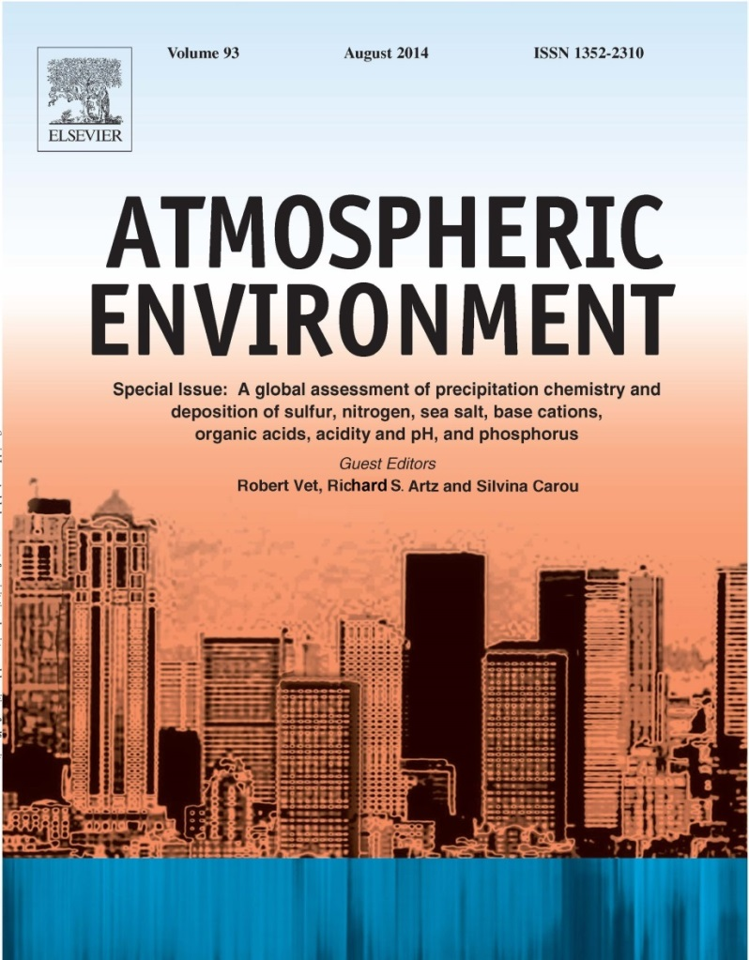
Quality
A Global Assessment
of
Precipitation Chemistry and Deposition of Sulfur, Nitrogen, Sea Salt, Base Cations, Organic Acids, Acidity and pH, and Phosphorus
R. Vet, R. Artz, S. Carou, M. Shaw, C.-U. Ro, W. Aas, A. Baker, V. Bowersox, F. Dentener, C. Galy-Lacaux, A. Hou, J. Pienaar, R. Gillett, M. C. Forti, S. Gromov, H. Hara, T. Khodzher, N. Mahowald, S. Nickovic, P. Rao, N. Reid
Published August, 2014
Google Scholar Reports 52 Citations as of April, 2016
Open Access: http://www.sciencedirect.com/science/journal/13522310/93/supp/C
Notes:
The full title shows the range of chemical compounds covered in the Assessment.
21 authors from 14 countries, including two authors from the US and five from Canada

Slide 9
Global Assessment - Background
Key Science Questions on Global and Regional Scales:
What are the spatial patterns of major ions* in precipitation and wet, dry and wet+dry deposition on global and regional scales?
What changes occurred in wet deposition from 2000 to 2007 (and, where data are available, since 1990)?
What are the major gaps, uncertainties and recommendations in global deposition monitoring?
* H, Ca, Mg, K, Na, NH4 NO3, PO4, SO4, Cl

Slide 10
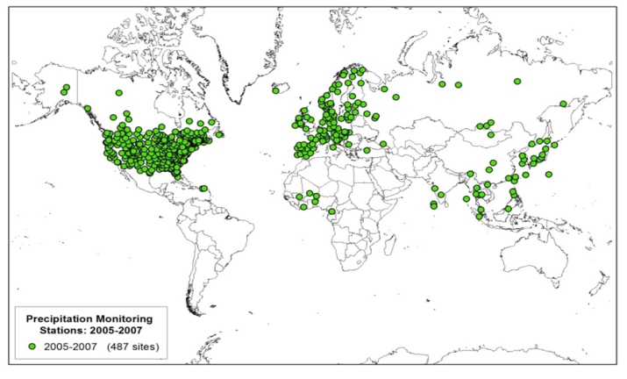
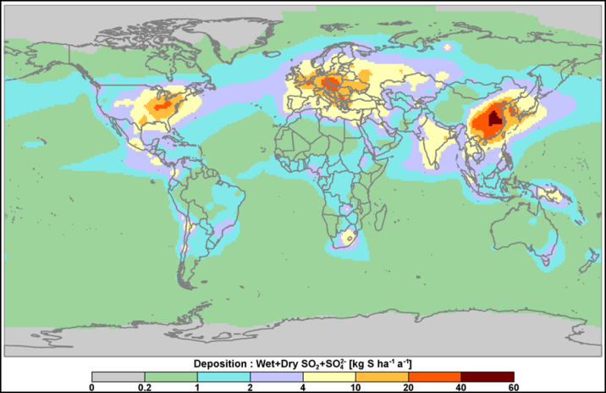
Global Assessment –
Approach
Temporal Period: 2000 to 2007
Spatial Scales: Global and Regional
Method: Combination of measurement
and modelling results
All major ions found in precipitation
470 Measurement sites
28 Global Models

Slide 11
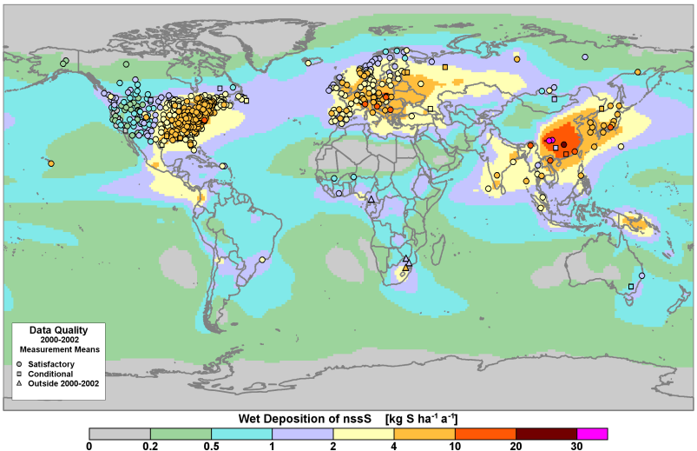
Products
Data Sets: quality-assured global data set of measurements from regionally-representative sites around the world
downloadable from the World Data Centre for Precipitation Chemistry (http://wdcpc.org/)
accessed/used by several scientific communities
Global maps:
Measurement-based, model-based, combined measurement-model
Available in the manuscript and the Addendum (Supplementary Material)
Notes:
Note: Slide adapted from 2014 NADP Technical Meeting Presentation by Robert Vet
The data compiled and used for this assessment represent the highest quality and most extensive data that could be obtained for this purpose. The data set used for this assessment is available for downloading from the World Data Centre for Precipitation Chemistry or WDCPC. This centre receives and archives precipitation chemistry data and complementary information from stations around the world. Data archived by this centre are accessible via connections with the WDCPC database. Freely available data from regional and national programmes with their own websites are accessible via links to these sites. The WDCPC is one of six World Data Centres in the World Meteorological Organization Global Atmosphere Watch (GAW). The focus on precipitation chemistry is described in the GAW Precipitation Chemistry Programme.
As a unique approach to filling data gaps globally, measurement data were combined with global chemical transport model results to provide detailed global patterns of precipitation chemistry and deposition for sulfur, nitrogen and sea salt.

Slide 12
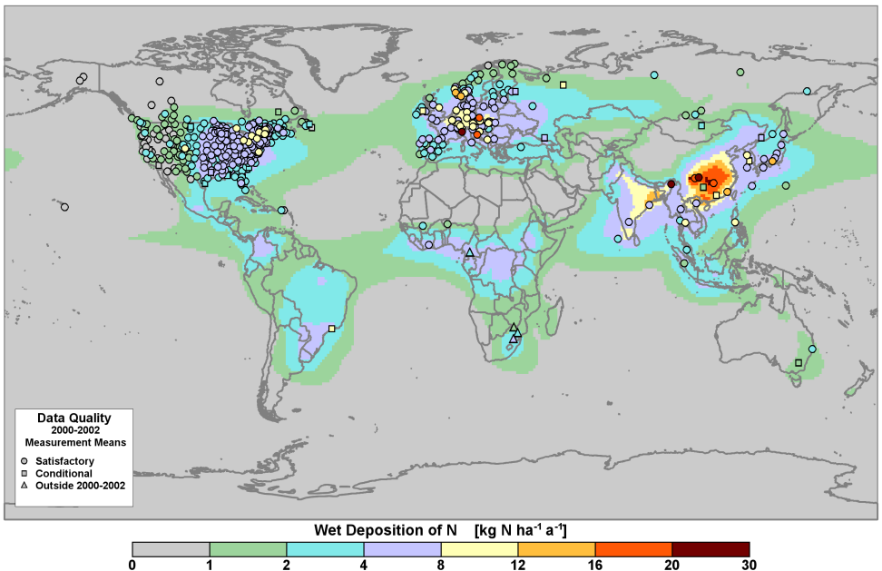
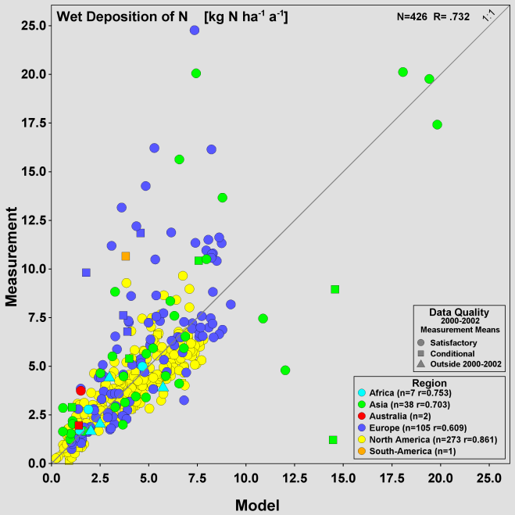
Nitrogen
Wet deposition of Oxidized + Reduced Nitrogen
Model versus Measurement Results
High deposition in eastern North America, Europe and Asia
Reasonable model-measurement comparability except in Europe and parts of Asia
Notes:
Note: Slide adapted from 2014 NADP Technical Meeting Presentation by Robert Vet

Slide 13
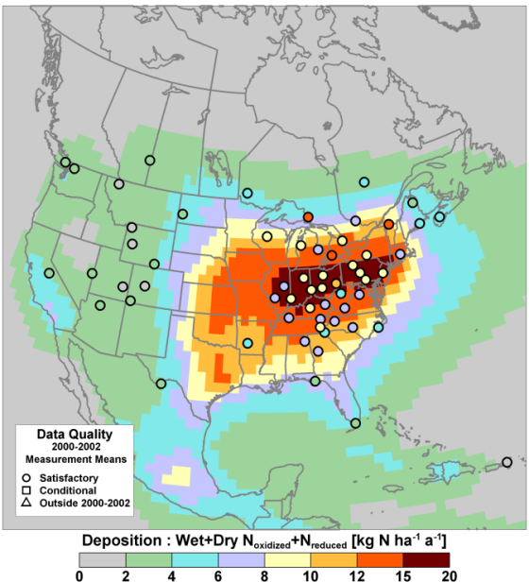
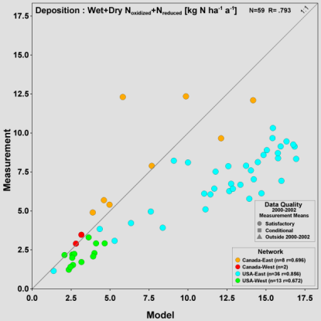
U.S and Canada: Wet+Dry Deposition of N (NO₂ and NH₃ not included in measured dry and total deposition)
Notes:
As expected, deposition for both measured and modeled species was high in eastern North America.
US and Canadian dry deposition estimates vary and agree poorly with modeled values.

Slide 14
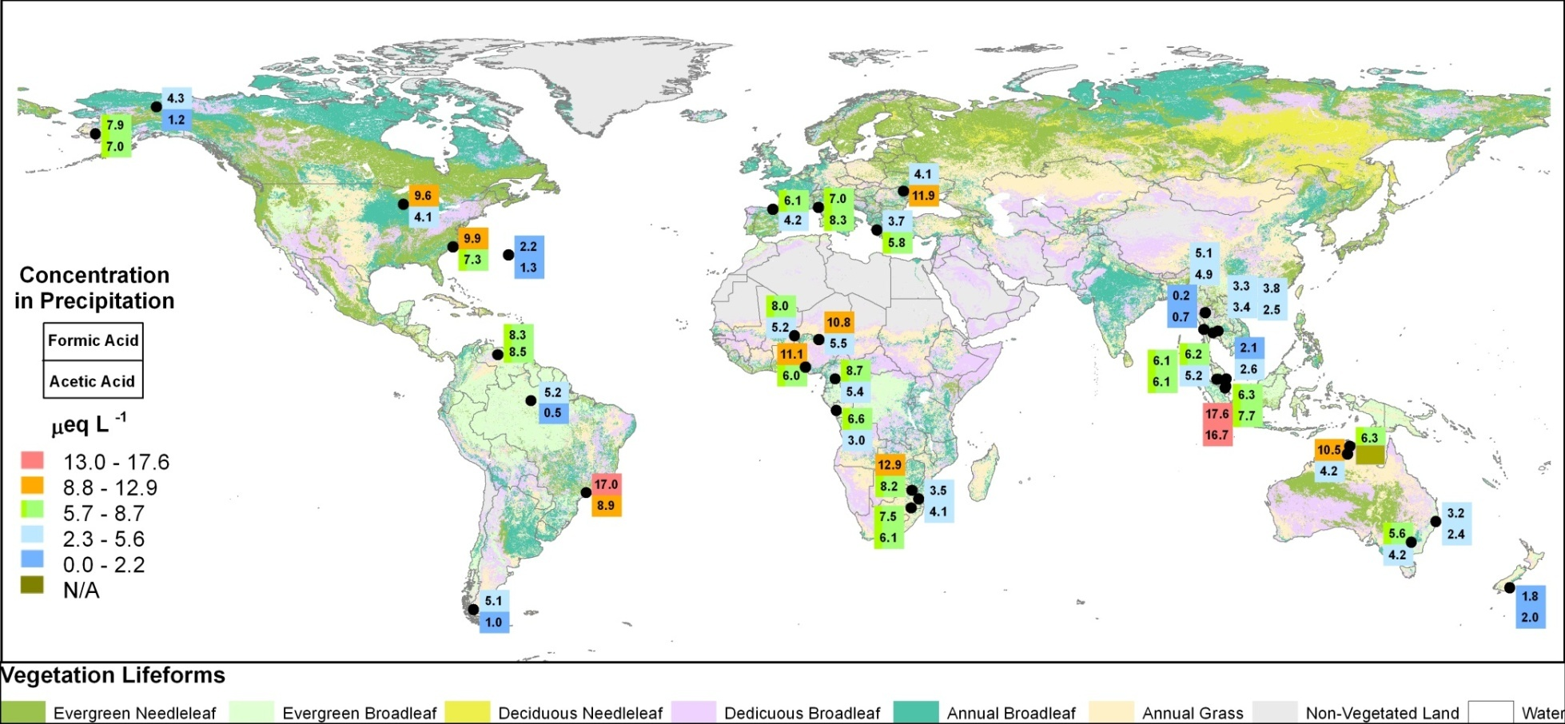
Organic Acids
Formic (top) and Acetic (bottom)
Concentration (µeq L⁻¹)
Notes:
Organic acids play an important role in controlling acidity in many areas of the world, especially in remote areas. Their influence appears to be increasing in North America as the influence of strong acids decreases.
Organic acids could potentially play a significant role in the production of secondary organic aerosol formation , and organic acids in the atmosphere are linked to photochemical smog events, usually resulting from urban emissions. Currently, the only parts of the world where organic acids are measured routinely are in Africa.

Slide 15
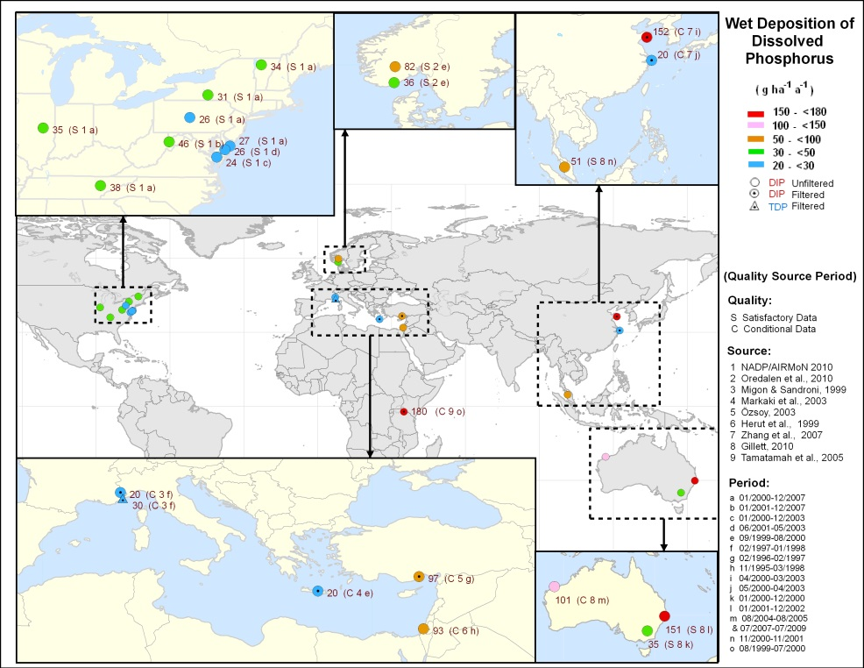
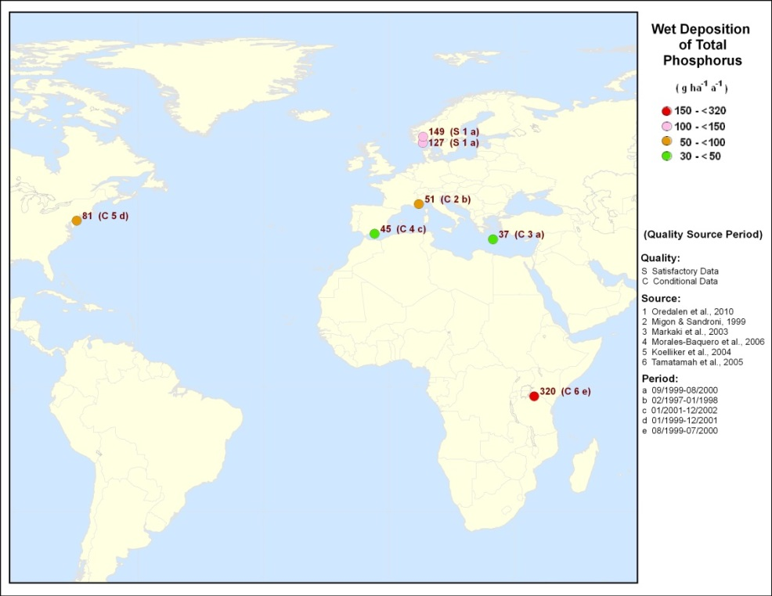
Wet Deposition of Dissolved Inorganic P
Wet Deposition of Total P

Slide 16
Key Scientific and Technical Challenges
Dry deposition is poorly monitored and inconsistently estimated worldwide.
Inferential dry deposition models need to be applied in other areas of the world where regionally-representative air concentration data are available.
Scientific direction is required to understand chemical cycling and to estimate wet and dry deposition of some important chemical species:
Phosphorus
Organic forms of nitrogen
Organic acids
Measurements, models and remote sensing results need to be combined (measurement/model fusion) to establish best spatial distributions of pollutants and deposition.
Large areas of the world are not monitored.
Notes:
Dry deposition is poorly monitored and inconsistently estimated worldwide. Canada and the USA need routine measurements of NO₂ and NH₃ to close the nitrogen deposition budget. The two countries also need to reconcile their inferential dry deposition models
Inferential dry deposition models need to be applied in other areas of the world where regionally-representative air concentration data are available, most notably Europe and Asia
Wet and dry deposition of phosphorus is poorly understood and measured worldwide; scientific direction is needed
Measurements are needed to evaluate and improve chemical transport models
Measurements, models and remote sensing results need to be combined (measurement/model fusion) to establish best spatial distributions of pollutants and deposition
There are large areas of the world, including areas where emissions are increasing, that remain under-monitored or not monitored

Slide 17
Key Scientific and Technical Challenges
Dry deposition is poorly monitored and inconsistently estimated worldwide.
Inferential dry deposition models need to be applied in other areas of the world where regionally-representative air concentration data are available.
Scientific direction is required to understand chemical cycling and to estimate wet and dry deposition of some important chemical species:
Phosphorus
Organic forms of nitrogen
Organic acids
Measurements, models and remote sensing results need to be combined (measurement/model fusion) to establish best spatial distributions of pollutants and deposition.
Large areas of the world are not monitored.

Slide 18
Key Scientific and Technical Challenges
Dry deposition is poorly monitored and inconsistently estimated worldwide.
Inferential dry deposition models need to be applied in other areas of the world where regionally-representative air concentration data are available.
Scientific direction is required to understand chemical cycling and to estimate wet and dry deposition of some important chemical species:
Phosphorus
Organic forms of nitrogen
Organic acids
Measurements, models and remote sensing results need to be combined (measurement/model fusion) to establish best spatial distributions of pollutants and deposition.
Large areas of the world are not monitored.

Slide 19
Key Scientific and Technical Challenges
Dry deposition is poorly monitored and inconsistently estimated worldwide.
Inferential dry deposition models need to be applied in other areas of the world where regionally-representative air concentration data are available.
Scientific direction is required to understand chemical cycling and to estimate wet and dry deposition of some important chemical species:
Phosphorus
Organic forms of nitrogen
Organic acids
Measurements, models and remote sensing results need to be combined (measurement/model fusion) to establish best spatial distributions of pollutants and deposition.
Large areas of the world are not monitored.

Slide 20
Key Scientific and Technical Challenges
Dry deposition is poorly monitored and inconsistently estimated worldwide.
Inferential dry deposition models need to be applied in other areas of the world where regionally-representative air concentration data are available.
Scientific direction is required to understand chemical cycling and to estimate wet and dry deposition of some important chemical species:
Phosphorus
Organic forms of nitrogen
Organic acids
Measurements, models and remote sensing results need to be combined (measurement/model fusion) to establish best spatial distributions of pollutants and deposition.
Large areas of the world are not monitored.

Slide 21
Next Steps
Update the guidance document
Provide guidance for measurement of total and ortho-phosphate, organic acids, organic N
Continue with the lab intercomparision program
Conduct global measurement-model fusion workshop in March, 2017 based in part on NADP techniques
Improve models
Benchmark with data
Estimate deposition in regions with no data
Develop outreach programs to relevant communities

Slide 22
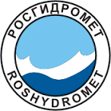
Performance: Collaborations

